Slide 1

A NOVEL FRAMEWORK FOR AUTOMATIC OBJECT DETECTION AND CLASSIFICATION OF BIO-DEGRADABLE AND NON-BIO-DEGRADABLE WASTE MATERIALS USING DEEPLEARNING
GUIDE NAME:
PRESENTED BY,
A.AGNESMARYLAVANYA(811721243004)
G.BRINDHA(811721243012)
D.SAHANA SRI(811721243046)
R.VINODHA(811721243062)
Mr.Joshua Issac., M.E
AP/AI.

Slide 2
OBJECTIVE
Design and implement a smart bin using AI for automatic waste classification
Capture and process waste images using a camera and deep learning model
Classify waste into biodegradable and non-biodegradable types
Automate waste segregation using Arduino and servo motors
Monitor bin fill level using sensors and communicate data via IoT modules

Slide 3
PROBLEM DEFINITION: EXISTING SYSTEM
Existing smart bins mainly rely on ultrasonic and motion sensors to detect waste levels
Manual waste segregation is still required after collection, reducing efficiency
Multi-bin setups increase infrastructure and maintenance costs
Public often misuses bins, placing waste in incorrect compartments

Slide 4
PROPOSED SYSTEM
Integrates a camera module and AI model (MobileNetV2) to classify waste in real time
Performs on-device image classification using a pre-trained deep learning model to reduce latency
Utilizes ultrasonic sensors to monitor fill levels and GPS for bin location tracking
Arduino and servo motors control compartment lids based on classification output

Slide 5
Sends bin status and location data via IoT module for centralized monitoring
Minimizes manual segregation, improves recycling accuracy, and supports smart city goals

Slide 6
LITERATURE SURVEY
S.No | PAPER TITLE | AUTHOR NAME | YEAR | TECHNIQUES | MERITS | DEMERITS
1 | Edge of things: The big picture on the integration of edge, IoT and the cloud in a distributed computing environment | H. El-Sayed, S. Sankar, M. Prasad | 2023 | Edge computing (EC) is proposed to pave the way for the evolution of new age applications and services. The edge of network devices such as smart phones, sensor nodes, wearable's, and on-board units, | Effective waste classification and prediction | Security risks and interoperability issues plague IoT cloud computing integration.
2 | A collaborative internet of things architecture for smart cities and environmental monitoring | Montori, F., Bedogni, L., Bononi | 2022 | An architecture, namely SenSquare, able to handle both the heterogeneous data sources coming from open IoT platform and crowdsensing campaigns, and display a unified access to users. | Real-time detection of illegal trash dumping | Data privacy concerns, and scalability limitations hinder smart city IoT architecture.

Slide 7
 | PAPER TITLE | AUTHOR NAME | YEAR | TECHNIQUE USED | MERITS | DEMERITS
3 | Smart and green urban solid waste collection systems: Advances, challenges, and perspectives | J. W. Lu, N. B. Chang, L. Liao | 2021 | An unified heuristic algorithm is proposed for addressing node routing and roll-on roll-off routing problems. | High accuracy in waste detection across different environments | Systems face high costs and scalability issues.
4 | Challenges and Opportunities of Waste Management in IoT-Enabled Smart Cities: A Survey | T. Anagnostopoulos, A. Zaslavsky | 2021 | Waste management involves not only the collection of the waste in the field but also the transport and disposal to the appropriate locations and ICT-enabled waste management models are discussed. | Improved image classification accuracy for solid waste | IoT-enabled small cities face waste management challenges and scalability issues.

Slide 8
 | PAPER TITLE | AUTHOR NAME | YEAR | TECHNIQUE USED | MERIT | DEMERITS
5 | Incorporating Intelligence in Fog Computing for Big Data Analysis in Smart Cities | B. Tang, Z. Chen, G. Hefferman | 2020 | A hierarchical distributed Fog Computing architecture to support the integration of massive number of infrastructure components and services in future smart cities. | Real-time waste identification capability | Smart cities leverage big data analysis for efficient urban planning.

Slide 9
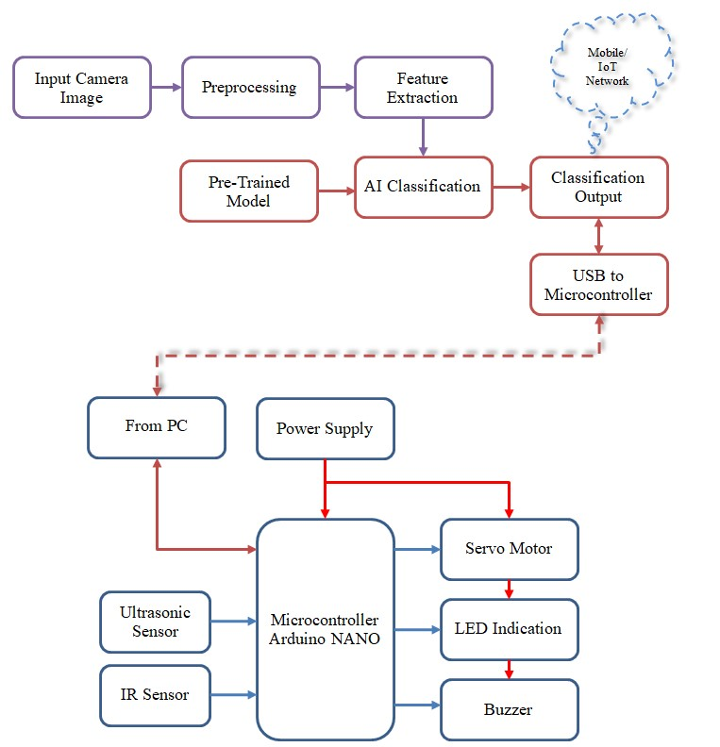
SYSTEM ARCHITECTURE

Slide 10
SYSTEM AND SOFTWARE SPECIFICATIONS
HARDWARE REQUIREMENT
Microcontroller Atmega328
Ultrasonic Sensor
IR Sensor
Buzzer
LCD display
Power supply
USB Cable

Slide 11
SYSTEM AND SOFTWARE SPECIFICATIONS
SOFTWARE REQUIREMENTS
For Image Processing
Python 3.6
For Hardware Module
Arduino IDE
For Microcontroller Embedded C Program
Proteus 7 Professional
For Project circuit Implementation

Slide 12
MODULES
Input Camera Image
Preprocessing
Feature Extraction
Pre-Trained Model
AI Classification
Classification Output

Slide 13
Input Camera Image
This part of the system uses a camera to take pictures of the waste when it is placed in the bin.
The camera is connected to a PC or Raspberry Pi and captures real-time images.
These images are the starting point of the process and help in knowing what type of waste is being thrown.
The quality of the image is important, so a good resolution camera is used.

Slide 14
Preprocessing
After capturing the image, the system prepares it for the AI model by resizing and cleaning it.
The image is resized to 224x224 pixels, adjusted for color and brightness, and converted into a format the model understands.
This step is done using Python and OpenCV tools.
Preprocessing helps the system work faster and makes sure the image is ready for the next step.
It also reduces errors and makes the final results more accurate.

Slide 15
Feature Extraction
In this step, the system looks at the image closely to find useful details like shape, color, and patterns.
These details help in telling the difference between plastic bottles, metal cans, and other waste items.
The AI model does this automatically using layers inside the MobileNetV2 model.
The features are turned into numbers that the system uses to understand what it is seeing.
This step replaces the need for manual checking or extra sensors.

Slide 16
Pre-Trained Model
The system uses a deep learning model called SSD MobileNetV2, which is already trained on waste images.
This model was created using TensorFlow and is ready to detect and classify objects quickly.
It runs on the PC or Raspberry Pi without needing the internet.
Since it’s already trained, we don’t have to build it from scratch, saving time and effort.
The model helps in detecting waste accurately and works well on devices with less power.

Slide 17
AI Classification
Once the model sees the image and finds the features, it decides what type of waste it is.
The waste is sorted into categories like plastic, metal, or paper.
This decision is sent to the Arduino using a USB cable.
The system works in real-time, giving quick results without delay.
This smart decision-making is much better than just using distance sensors like in older systems.

Slide 18
Classification Output
After the AI decides the type of waste, the Arduino gets the result and moves the waste to the correct bin.
It controls servo motors to open the right compartment—plastic, metal, or general waste.
A display can show what type of waste was detected.
The ultrasonic sensor also checks how full the bin is, and this information can be sent using Wi-Fi or GSM.
This final step ensures the waste is sorted properly, helping with recycling and keeping the environment clean.

Slide 19
ADVANTAGES
Waste is separated without human help, reducing manual effort.
The system identifies waste instantly as it is thrown in.
Proper segregation increases recycling efficiency and reduces landfill use.
Prevents mixing of waste types, which can cause contamination and environmental harm.
Uses lightweight models and affordable hardware like Arduino and Raspberry Pi.

Slide 20
APPLICATIONS
Smart Cities: Can be installed in public places to support clean and green urban environments.
Educational Institutions: Promotes waste awareness and automation in schools and colleges.
Hospitals and Offices: Helps separate medical or electronic waste from general trash.
Municipal Waste Systems: Supports local authorities in better waste handling and route planning.

Slide 21
CONCLUSION
Successfully developed a smart bin system for automatic waste classification
Integrated camera, sensors, and deep learning for real-time detection
Achieved efficient waste segregation using MobileNetV2 and Arduino control
Enhanced sustainability and reduced manual effort in waste management
Future work includes expanding dataset and implementing smart routing for waste collection

Slide 22
REFERENCE
H. El-Sayed, S. Sankar, M. Prasad, D. Puthal, A. Gupta, M. Mohanty, and C.-T. Lin, ‘‘Edge of things: The big picture on the integration of edge, IoT and the cloud in a distributed computing environment,’’ IEEE Access, vol. 6, pp. 1706–1717, 2018
Montori, F., Bedogni, L., Bononi, L.: ‘A collaborative internet of things architecture for smart cities and environmental monitoring’, IEEE Internet Things J., pp. 592–605, 2018
J. W. Lu, N. B. Chang, L. Liao, and M. Y. Liao, “Smart and green urban solid waste collection systems: Advances, challenges, and perspectives,” IEEE Systems Journal, vol. 11, no. 4, pp. 2804–2817, Dec 2017.
T. Anagnostopoulos, A. Zaslavsky, K. Kolomvatsos, A. Medvedev, P. Amirian, J. Morley, and S. Hadjieftymiades, “Challenges and Opportunities of Waste Management in IoT-Enabled Smart Cities: A Survey,” IEEE Transactions on Sustainable Computing, vol. 2, no. 3, pp. 275– 289, 2017
B. Tang, Z. Chen, G. Hefferman, S. Pei, T. Wei, H. He, and Q. Yang, “Incorporating Intelligence in Fog Computing for Big Data Analysis in Smart Cities,” IEEE Transactions on Industrial Informatics, vol. 13, no. 5, pp. 2140–2150, 2017

Slide 23
THANK YOU!!!

